Slide 1
State Machines
What are they, When to use them, and How to make them
Nathan Clark
Local Unity Developer, he/him

Slide 2
What is a State Machine?
Finite State Machine (FSM)
Model of behavior
A state machine is made up of:
States
Condition of a system
Transitions
How the state of a system changes

Slide 3
What is State and what does it do?
State is the description of the condition of a system
jumping, running, climbing, swimming, etc.
Angry, Scared, Asleep, Happy, Sad, etc.
A system is only in one state at a time
What does state do?
Defines what behavior is going to be running
Scared => runs away
Angry => attack player

Slide 4
Example State Machine Diagram
Flip Switch Down
Light On
Light Off
Does this look familiar?
Flip Switch Up

Slide 5
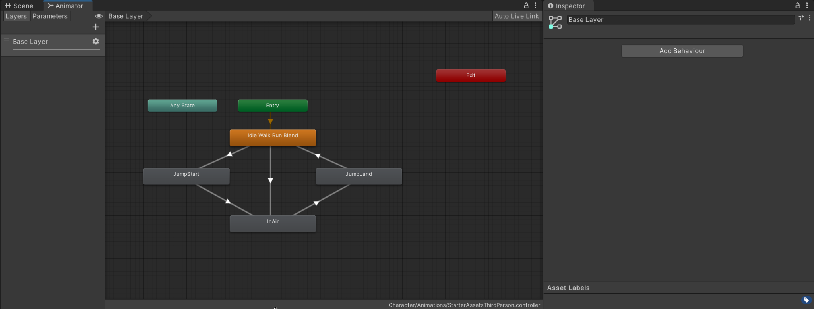
Unity Animator
The Animator is an example of a state machine

Slide 6
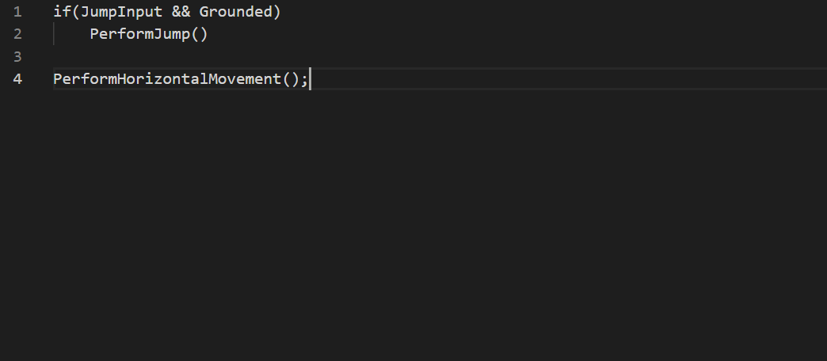
Why do we use State Machines?
Compartmentalize behavior
Example pseudocode for Character Controller
This is simple and it will work, but what happens when we add more states.

Slide 7
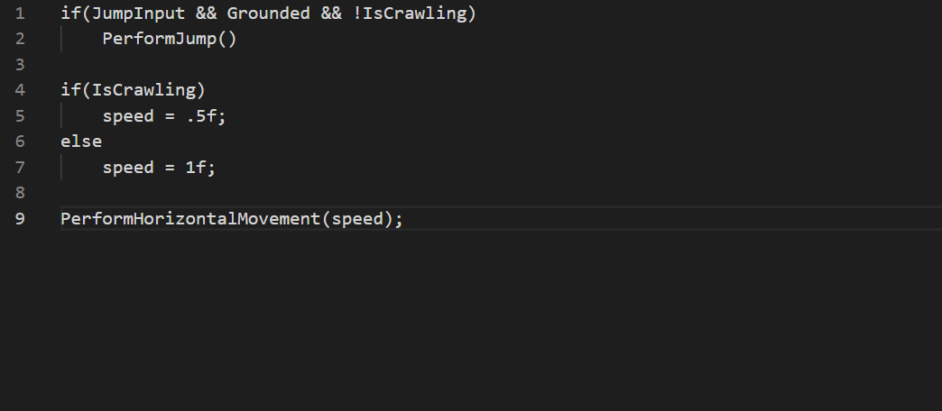
Why do we use State Machines?
Compartmentalize behavior
Example pseudocode for Character Controller
This is simple and it will work, but what happens when we add more states.

Slide 8
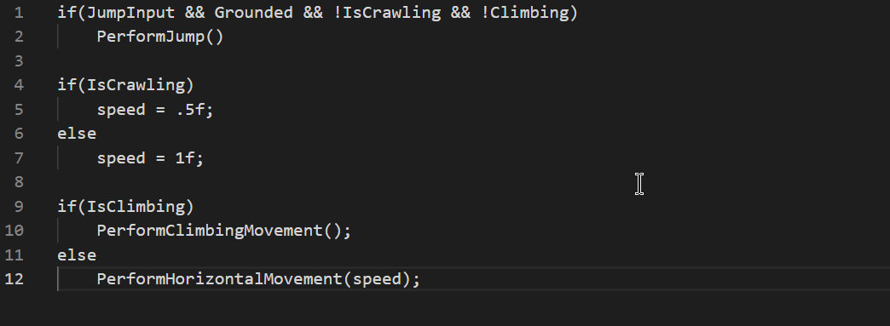
Why do we use State Machines?
Compartmentalize behavior
Example pseudocode for Character Controller
This is simple and it will work, but what happens when we add more states.
Things can get complex very quickly.
If statements scattered throughout

Slide 9
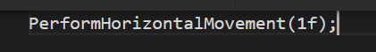
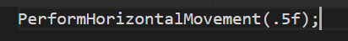
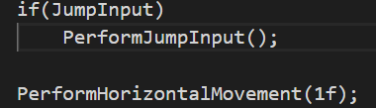
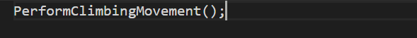
Why do we use State Machines? (cont.)
Jump State
Grounded State
Crawl State
Climb State

Slide 10
How do we implement a State Machine?
Making a state machine is like cooking an egg
Lots of ways to do it
The easy ways don’t always taste great, and the hard ways aren’t always worth it
Minimum Requirements
States
Transitions

Slide 11
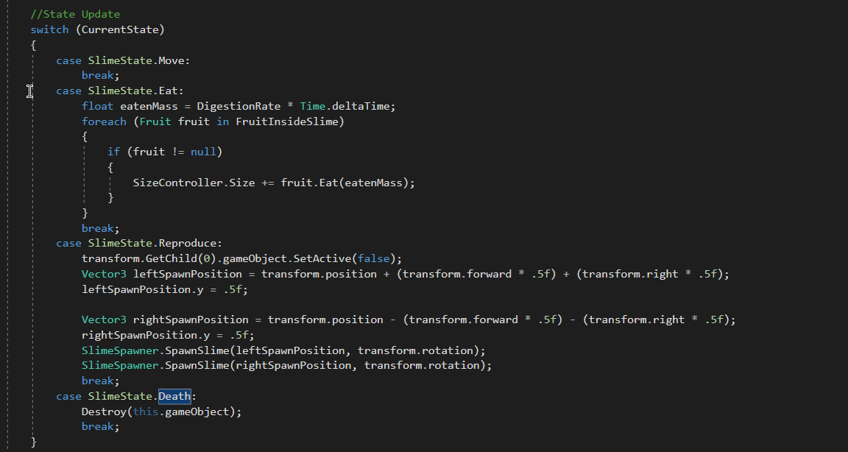
Enums and Switch Statements (or if else if)
The easiest way to make a state machine
Flawed
Long, bloated scripts
No reusability
Use it when you need something simple
And quick

Slide 12
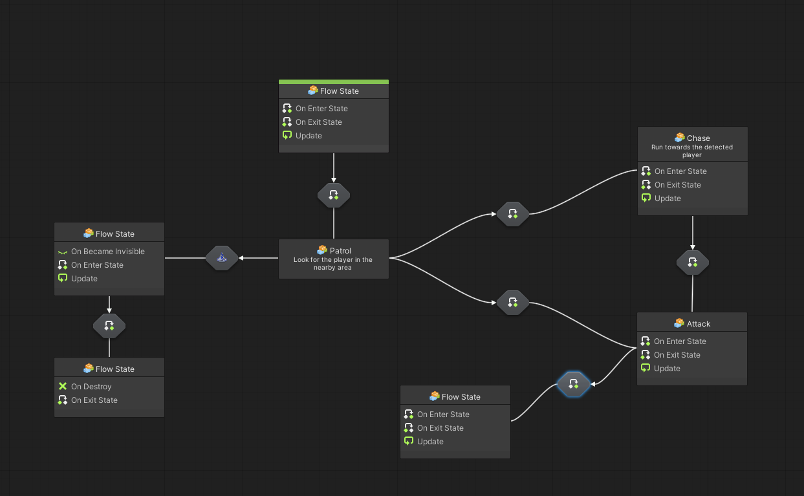
Visual Scripting Package

Slide 13
Using Components as State
Only slightly more difficult than switch statement
StateMachine component that enables and disables State components based on the current state
Reusable?
Potential problems
My opinion
Not worth it

Slide 14
Practical Implementation Time
My preferred way to make State Machines
Interfaces and ScriptableObjects

Slide 15
Ways to Improve
Reusability Issues
Transitions inside of State
States only accept SlimeStateMachine
What Functionality Belongs Inside StateMachine

Slide 16
Things we could’ve added
Any State Transitions
On Enter, On Exit
Really useful, Easy to implement, but wasn’t necessary for the Slime

Slide 17
Things we could’ve added (cont.)
Sub State Machine
Basically a more complex state with it’s own internal State Machine to determine it’s behavior
Composite State
State that combines multiple behaviors
For example, a Composite State that has both a MoveState and EatState
Move and Eat at the same time
Potentially Dangerous - use with caution

Slide 18
Final Thoughts
Time Sink
Add features as needed
State Machines are a good tool
Learn to know when to use a hammer and not a drill

Slide 19
Questions?
https://github.com/ndclark94/StateMachines

